Slide 1
TERPCravingz
A business analytics solution for the eatery review platform
2019.12.3 Aishwarya Bhangale Cindy Chang Wenjing Cui Huyen Nguyen Jiakun Luo

Slide 2
Outline
Background
Introduction
Conceptual Database Design: ER diagram
Logical Database Design: relational schema
Physical Database Design
Use Cases
Application

Slide 3


Background
Client
End-Users
Entrepreneurs
People who are looking for restaurant business opportunities nearby UMD and needed analysis insights for decision making
TERPCravingz
A local restaurant review platform that showcases restaurant information, restaurant review information and UMD Shuttles to the restaurant of choice.
Consumers
How do I get to a Vegetarian restaurant that has above average rating and on UMD shuttle routes?

Slide 4

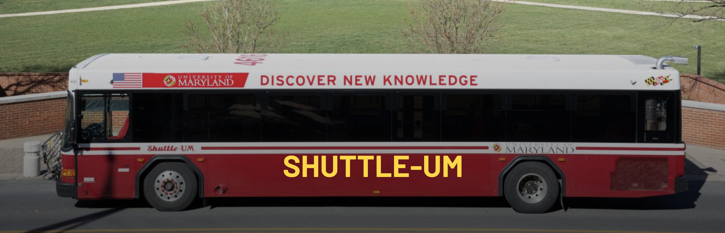
Background
Data Source:
Yelp: data of 2799 restaurants in cities nearby UMD
UMD DOTs: data of all shuttles

Slide 5
Introduction
TERPCravingz has a demand for improvement of customer experience:
To add exclusive new transportation info feature for UMD students or local residents without cars:
By incorporating UMD-Shuttle bus stops to TERPCravingz’ restaurant search system.
Increase analytical insights:
By adding analytical dashboards so that the entrepreneur users can have an overall idea immediately of what the restaurant business trends are in certain regions; customers can have more info about the best restaurants around.

Slide 6
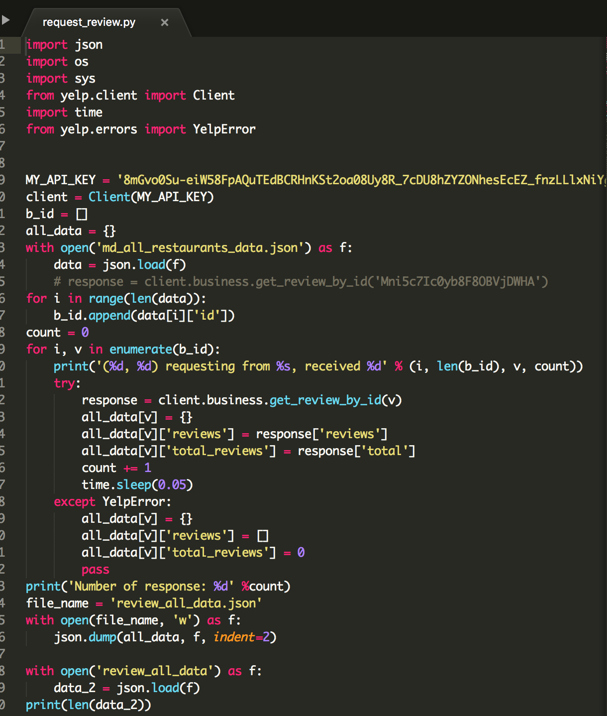
Work Flow
Extract Data
Scraped Data from Yelp and UMD DOTs with Python
Transform Data
Data preprocessing and cleaning. Getting rid of null values and duplicates. Adjust data types.
Load Data
Create tables and insert data into SQL database
Analyze Data
Using SELECT statements and Tableau to visualize business transactions

Slide 7
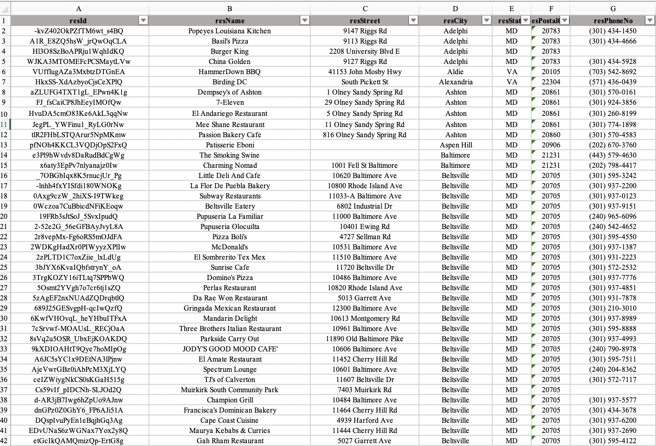
Work Flow
Extract Data
Scraped Data from Yelp and UMD DOTs with Python
Transform Data
Data preprocessing and cleaning. Getting rid of null values and duplicates. Adjust data types.
Load Data
Create tables and insert data into SQL database
Analyze Data
Using SELECT statements and Tableau to visualize business transactions

Slide 8
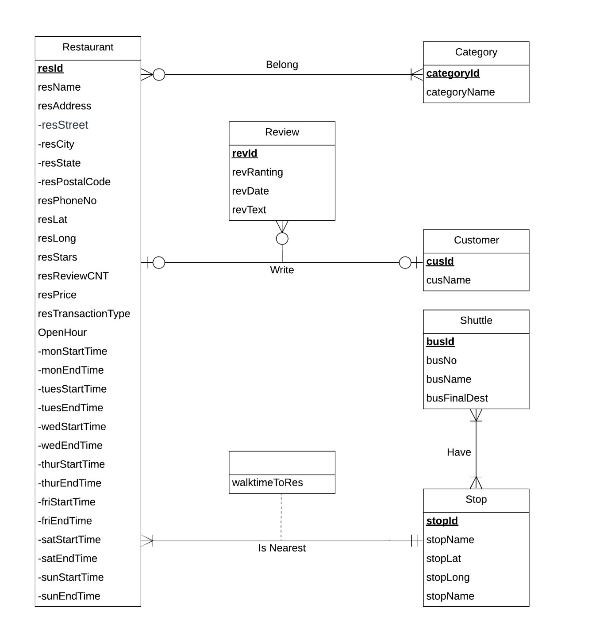
ER Diagram

Slide 9
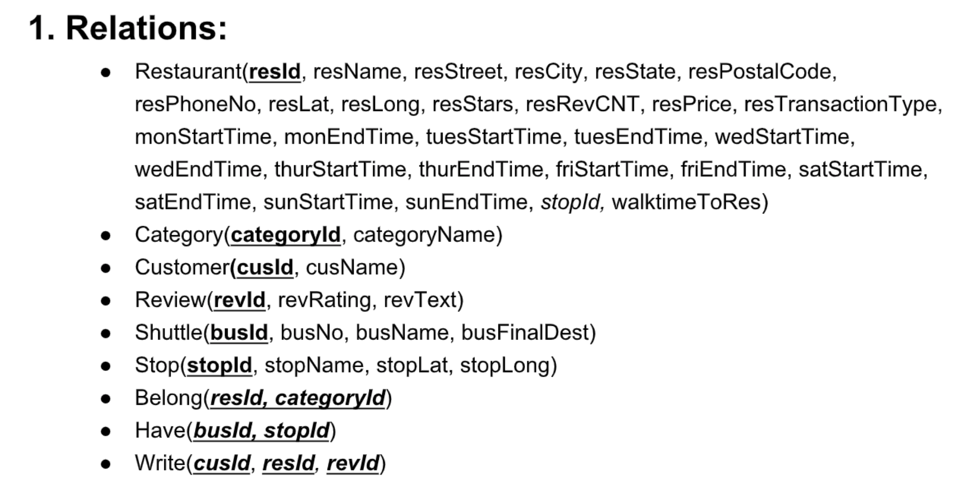
Relational Schema

Slide 10
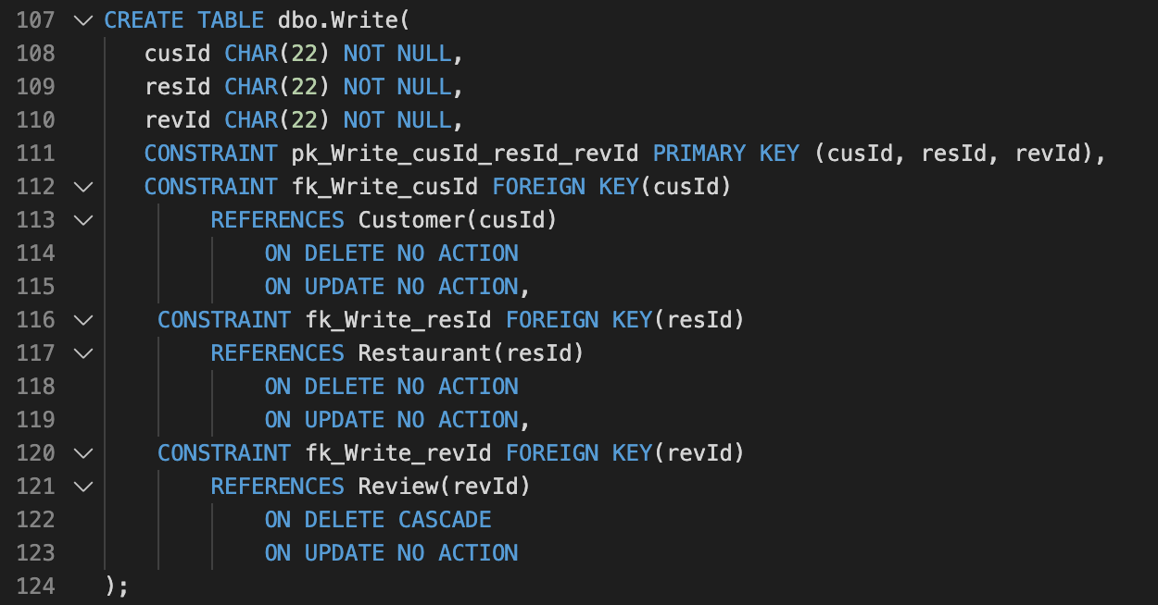
Physical Database Design

Slide 11
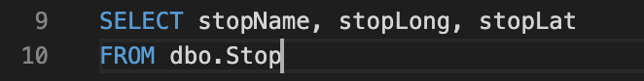
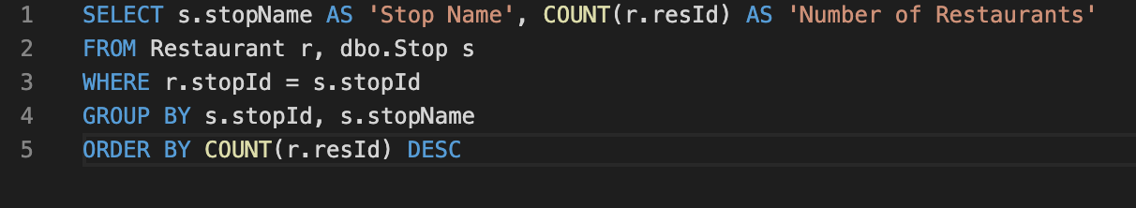
Use Case 1
What is the geographical distribution of the shuttle stops?
What is the number of restaurants nearest to each stop?

Slide 12
Use Case 2
What is the geographical distribution of the shuttle stops?
What is the number of restaurants nearest to each stop?

Slide 13
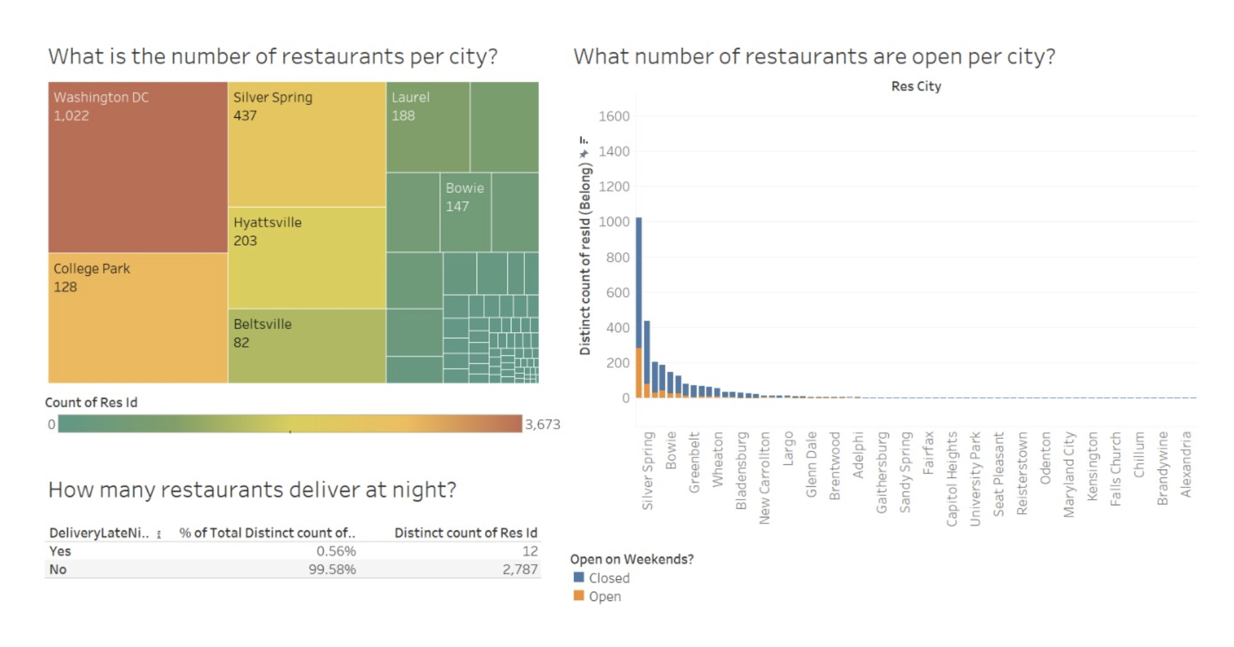
Application1

Slide 14
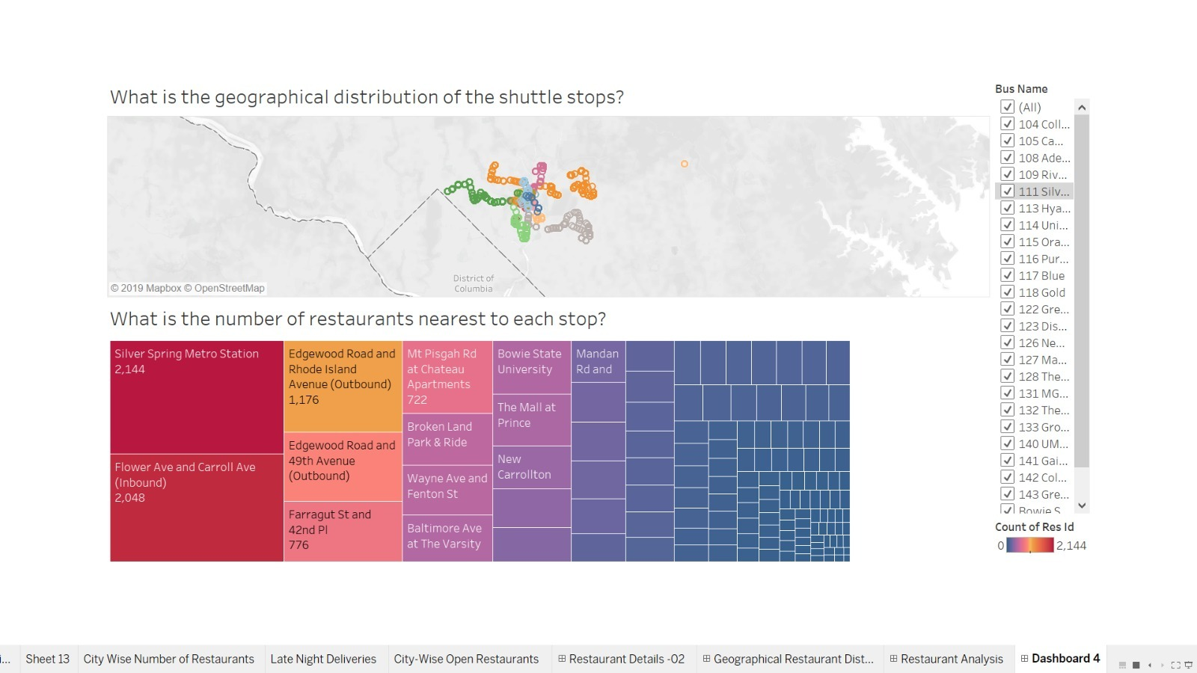
Application2

